Slide 1
Soil Profile
Utah State Science Standards 4th grade:
3.3a Observe & list the components of soil (minerals, rocks, air, water, living & dead organisms) and distinguish between the living, nonliving & once living components of the soil.
3.3b Diagram or model a soil profile showing topsoil, subsoil, & bedrock and how they differ in composition.

Slide 2
SOIL PROFILE
Side view of different layers of the soil.
View of the soil like a slice of cake.
www.geograph.org.uk

Slide 3
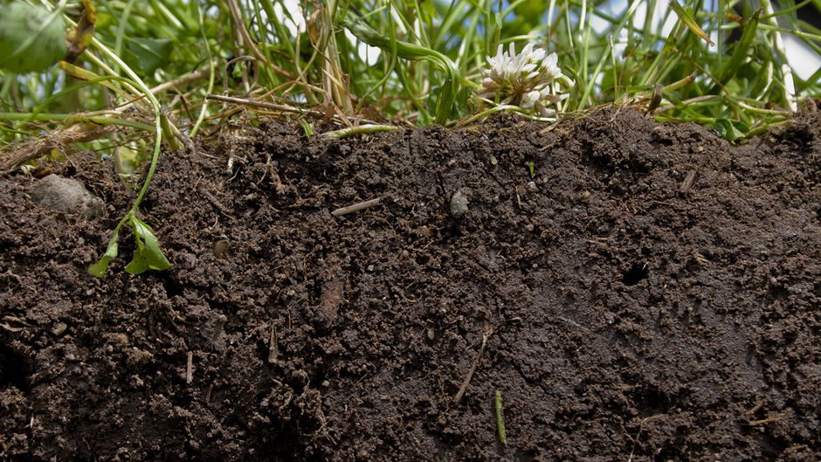
TOP SOIL
www.ourworldunu.edu

Slide 4
TOP SOIL
Top layer of soil profile
Made up of large, medium and small particles
Composed of organic material (from once-living things) and nonliving material (water, air, minerals)
Usually darker in color
Contains organisms (anything that was alive or is alive)
Earthworms, insects, and snails
Decompose dead plant and animal material, more nutrients are added to soil Plants and grass
Rich in nutrients (substances organisms need to survive and grow)
www.thunderboltkids.co.za
Takes 1,000 years to make 1 inch

Slide 5
SUBSOIL
Middle layer of soil profile
Lighter in color
Larger grains of rocks and minerals
Plants do not grow well
Particles packed tightly
Few nutrients
En.Wikipedia.org

Slide 6
BEDROCK
Bottom layer of soil profile
Solid rock not broken down
Different rocks in different places
Erodes and becomes topsoil
Can be close to the surface or far below surface
Couple inches or many feet
Ko.Wikipedia.org

Slide 7
SOIL PROFILE QUIZ Which layer is it?

Slide 8
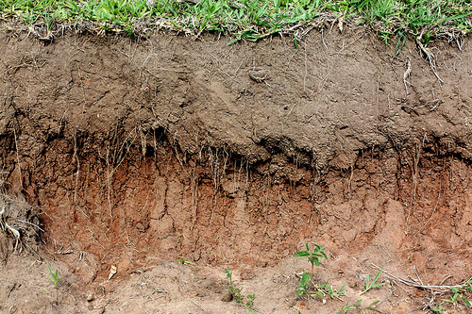
Aquinta.org

Slide 9
SUBSOIL
Aquinta.org

Slide 10
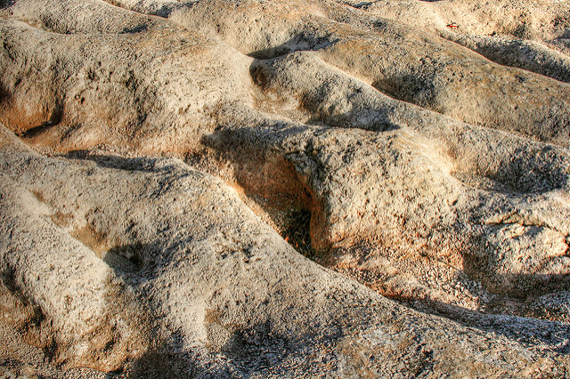
Flicker.com

Slide 11
BEDROCK
Flicker.com

Slide 12
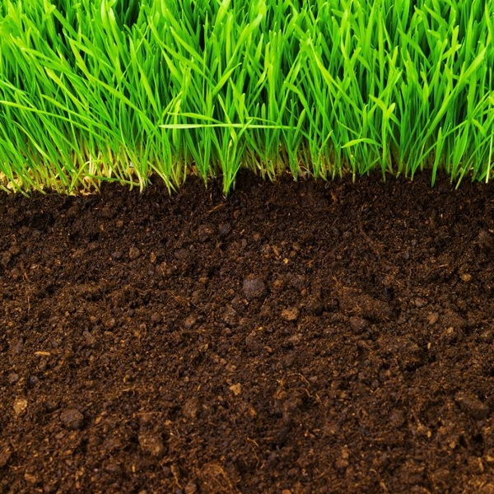
www.citysearch.com

Slide 13
TOPSOIL
www.citysearch.com

Slide 14
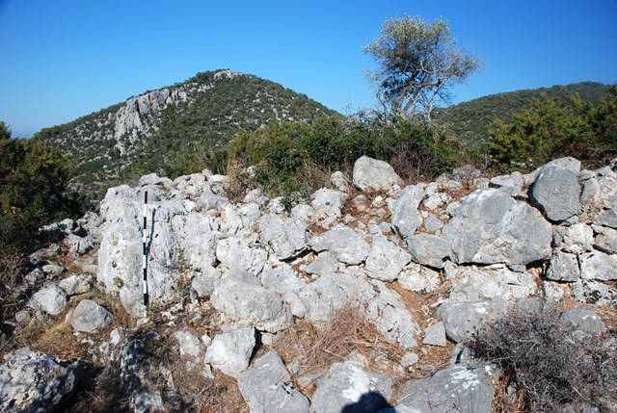
Mediterraneanworld.typepad.com

Slide 15
BEDROCK
Mediterraneanworld.typepad.com

Slide 16
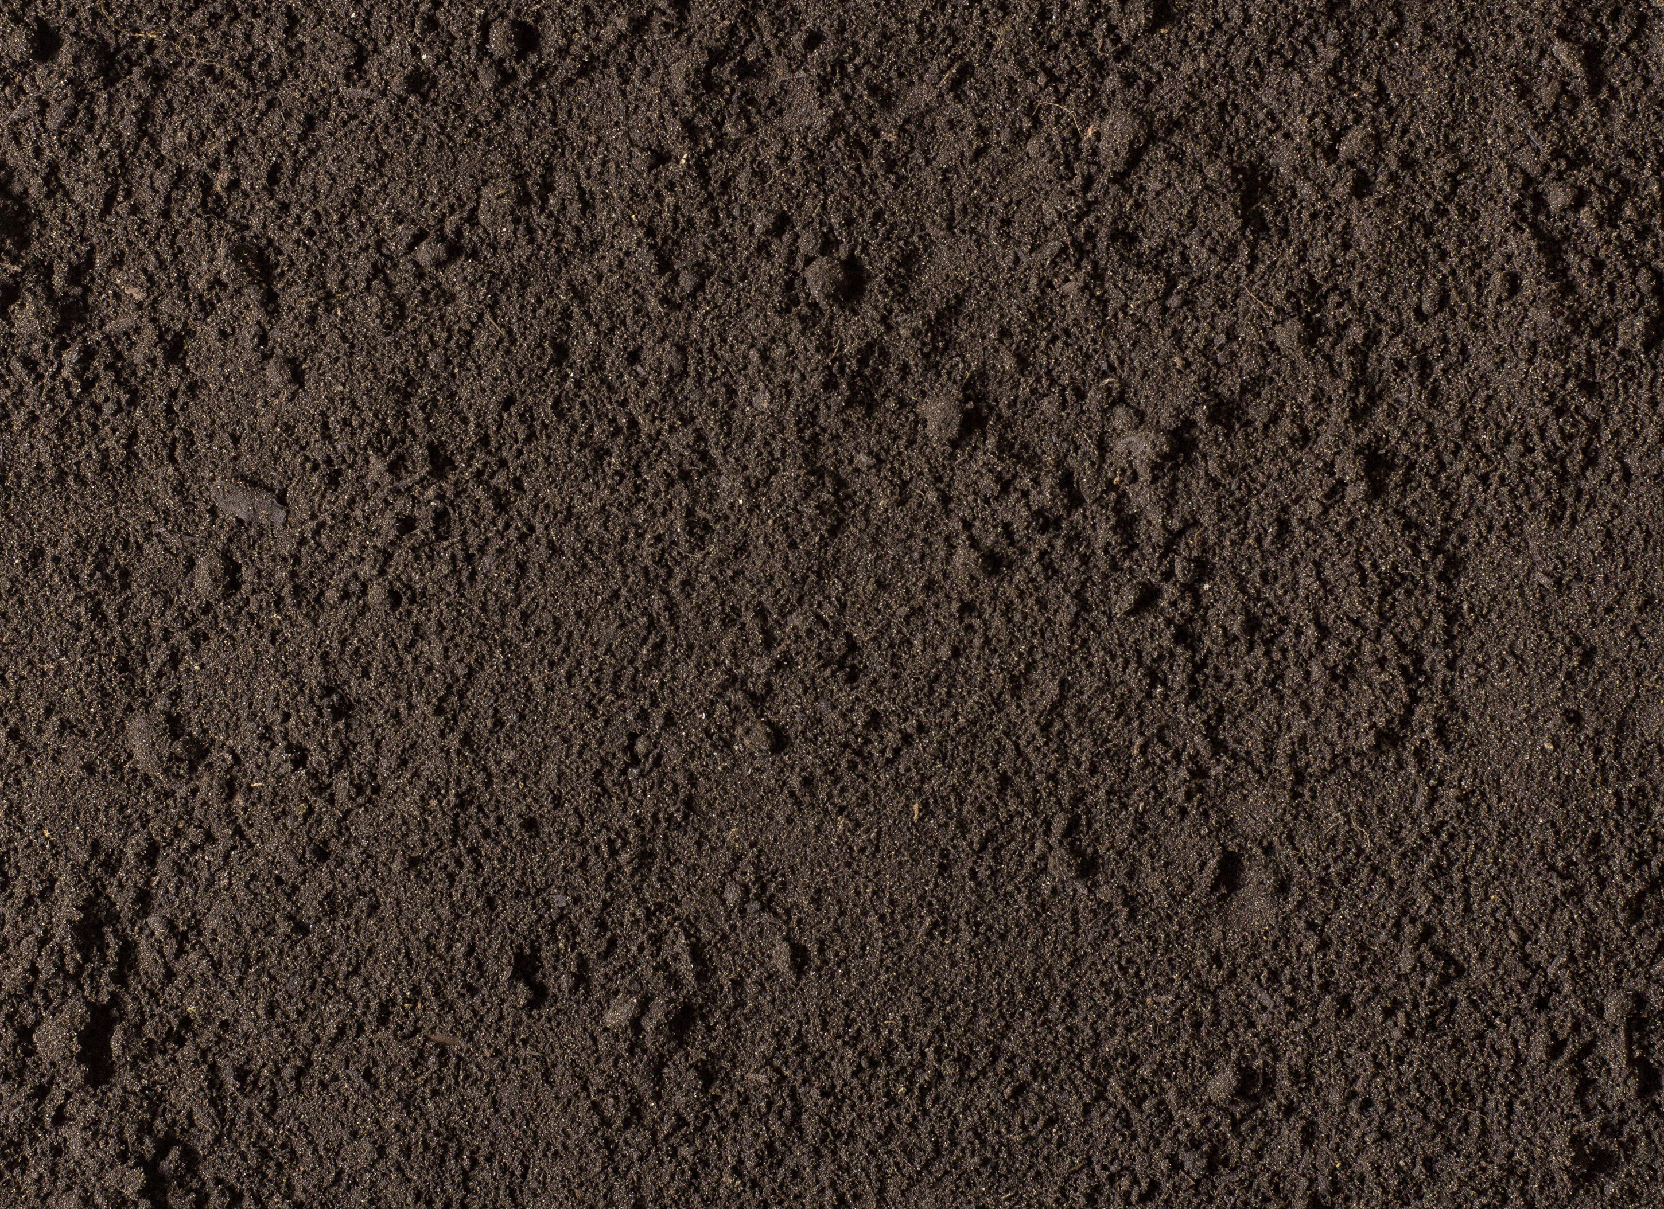

Slide 17
TOPSOIL

Slide 18
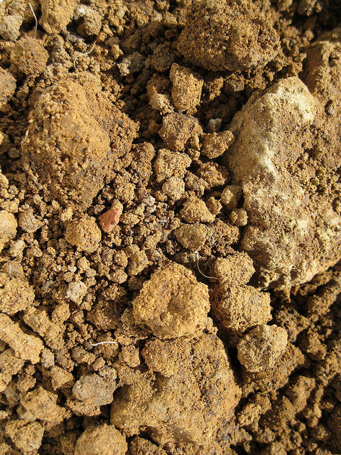
Flicker.com

Slide 19
SUBSOIL
Flicker.com

Slide 20
Hands on activity ☺

Slide 21
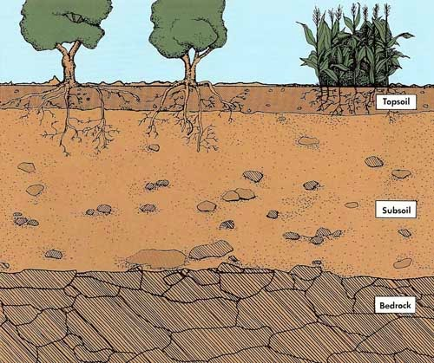
Soil Profile
_____________________________________
1.____________________________
2.____________________________
3.____________________________
4.____________________________
5.____________________________
6.____________________________
_____________________________________
1.____________________________
2.____________________________
3.____________________________
4.____________________________
5.____________________________
6.____________________________
_____________________________________
1.____________________________
2.____________________________
3.____________________________
4.____________________________
5.____________________________
6.____________________________

